Slide 1
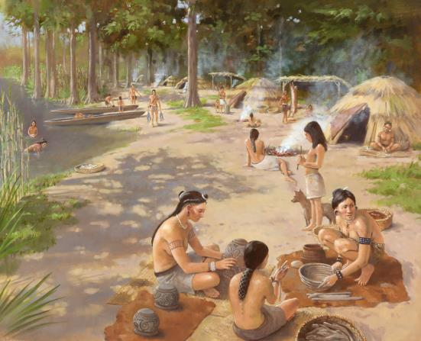
Prehistoric Louisiana
Learn about Louisiana’s Past through Archaeology
Notes:
Title: Prehistoric Louisiana
Image credit: Martin Pate

Slide 2
Prehistoric Louisiana
Painting by Martin Pate
Prehistoric Life in Louisiana
Notes:
Prehistoric Louisiana
American Indians lived in what is now Louisiana for thousands of years before the arrival of Europeans. This module introduces this time in Louisiana’s past and shows what life was like for these early people.
Image credit: Martin Pate

Slide 3
Prehistoric Louisiana
Archaeology tells us about people in the past:
Artifacts and changes to the land
Where they lived
How they lived
Tools, Weapons
Food
People and Settlements
Earth Mounds and Homes
Notes:
Prehistoric Louisiana
Archaeology is the study of people who lived in the past. Archaeologists study past people through the things they left behind or changes they made to the land. Artifacts are the things people leave behind. Artifacts give clues to where people lived, the tools and weapons they used, and what foods they ate. Artifacts can also tell us about interactions people had within their group as well as with other groups. People who lived in the past made changes to the land, such as building earth mounds or constructing homes. Archaeology can tell us about the kinds of homes people built.
Archaeologists divide human history into two major periods, prehistoric and historic. Whether a culture or time period had writing is what separates these two classifications. Prehistoric is before writing, and historic after writing.

Slide 4
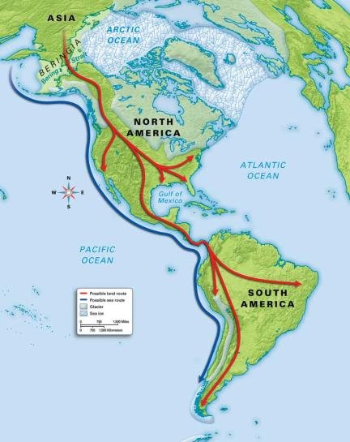
Prehistoric Louisiana
Migration Routes
Notes:
Prehistoric Louisiana
How did the first people come to Louisiana? Archaeologists agree that people came from Asia to North America at different times and in different groups. The initial idea was that people walked across the Bering Land Bridge from Asia to Alaska. This land bridge appeared after the large ice sheets covering North America began to melt. Later, archaeologists discovered new evidence that gave more clues about when and how people came to North America. Now, archaeologists think that some people traveled across the land bridge, while others traveled along the coast in small boats. This image shows the two routes.
Once people arrived in North America, they followed animals to various parts of the country. Louisiana was a lush setting. It offered a variety of food items, as well as a milder climate than other parts of North America. It is not a surprise that some people decided to make Louisiana their home.
Image credit:
Migration map – https://mrgrayhistory.wikispaces.com/UNIT+8+-+EARLY+AMERICAS

Slide 5
Prehistoric Louisiana
Paleoindian Period
11,500-8000 B.C.
Woodland Period
800 B.C.-A.D. 1200
12,000 B.C. | 10,000 B.C. | 8000 B.C. | 6000 B.C. | 4000 B.C. | 2000 B.C. | A.D. 1 | A.D. 2000
Archaic Period
8000-800 B.C.
Mississippi Period
A.D. 1200-1700
Prehistoric Periods in Louisiana
Notes:
Prehistoric Louisiana
Archaeologists divide Louisiana’s prehistory into four periods: Paleoindian, Archaic, Woodland, and Mississippi. The periods go back to about 11,500 years B.C. Each period is different from the previous one because of changes in culture and technology. Examples of these changes were the tools people used, the type of pottery made, and how people lived. Archaeologists describe and classify human societies based on these changes.

Slide 6
Prehistoric Louisiana
In this module:
Archaeological time periods in Louisiana
Climate and landscape
Food
Tools and weapons
People and settlements
Louisiana sites
Notes:
Prehistoric Louisiana
This module is an introduction to the prehistoric time periods in Louisiana. Each time period begins with information on the climate and landscape. Next is information on the foods, and tools and weapons used by the people who lived during that time. The daily lives of people and what their settlements looked like is presented next. At the end of each time period we will talk about a site from that time period.
Sit back and relax as we travel through 13,200 years of prehistory in Louisiana.

Slide 7
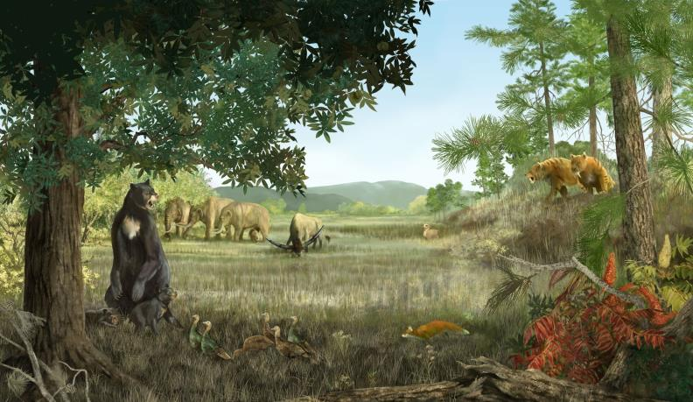
Prehistoric Louisiana
Paleoindian Period – 11,500 to 8000 B.C.
Artwork © Karen Carr
Paleoindian Period Climate and Landscape
Notes:
Paleoindian Period – Climate and Landscape
The climate of the Paleoindian Period in Louisiana was cooler and wetter than our climate is today. Forests covered the land, and seas were lower. This meant that dry land extended farther into the Gulf of Mexico than today. Large mammals, like mastodons and long-horn bison, roamed the land.
Image credit: Copyright Karen Carr

Slide 8
Prehistoric Louisiana
Paleoindian Period – 11,500 to 8000 B.C.
Drawing by Phyllis Lear
Paleoindian Period Food
Notes:
Paleoindian Period – Food
Paleoindians hunted deer, squirrels, rabbits and birds. They also fished the streams and bayous. Sometimes Paleoindians brought down large mammals, like mastodons. They didn’t just eat meat. Paleoindians also gathered wild local plants, nuts, seeds and berries to eat.
Image credit: Phyllis Lear

Slide 9
Prehistoric Louisiana
Paleoindian Period – 11,500 to 8000 B.C.
Atlatl
Spear Points
Drawing by Phyllis Lear
Dart Points
Stone point drawings by David Griffing
Paleoindian Period Tools and Weapons
Notes:
Paleoindian Period – Tools and Weapons
Paleoindians used stone tools to hunt wild game. Louisiana doesn’t have much stone naturally, so some of the stone came from Texas during this time. This means that people traveled here from Texas, or the Indians in Louisiana traded with people living in Texas. The stone points were medium to large, and could be re-sharpened many times. Early in the Paleoindian period people hunted with spears. Later Paleoindians used spears and throwing sticks, or atlatls (pronounced at LAT l).
Image credits:
Indian hunting – Phyllis Lear
Stone points – David Griffing

Slide 10
Prehistoric Louisiana
Paleoindian Period – 11,500 to 8000 B.C.
Drawings by Phyllis Lear
Paleoindian Period People and Settlements
Notes:
Paleoindian Period – People and Settlements
Paleoindians in Louisiana moved around frequently. Sometimes they moved with the change of seasons. Once food became scarce in an area, they would move to another area. They might travel long distances to find food.
Paleoindians built shelters out of hides or woven mats, and made clothes from animal skins. Each family cooked food over a campfire, and two or more families might have shared a campsite.
Image credit: Phyllis Lear

Slide 11
Prehistoric Louisiana
Paleoindian Period – 11,500 to 8000 B.C.
John Pearce Site
Caddo Parish
Paleoindian Period Site
Notes:
Paleoindian Period – Archaeological Site
Here is a map showing a Paleoindian Period site in Louisiana. This is the John Pearce site in Caddo Parish near Shreveport.
Image credit: Louisiana Division of Archaeology

Slide 12
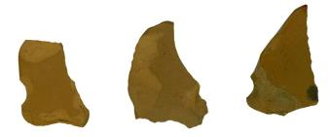
Prehistoric Louisiana
Paleoindian Period – 11,500 to 8000 B.C.
Stone Scrapers
Stone Points
Images by Charlotte Pevny
John Pearce Site, around 8000 B.C.
Notes:
Paleoindian Period – Archaeological Site
The John Pearce site was a Paleoindian camp site. Two different activity areas were found. Each had a series of stone points used for hunting. Knives used for butchering animals, and tools for scraping various materials were found. The artifacts at the site indicate this camp was used for hunting animals. Archaeologists did not recover any evidence of which animals were hunted.
Image credit: Charlotte Pevny

Slide 13
Prehistoric Louisiana
Archaic Period – 8000 to 800 B.C.
Artwork by Steven Patricia
Archaic Period Climate and Landscape
Notes:
Archaic Period – Climate and Landscape
The Archaic Period, also known as the Meso-Indian Period, was warmer and drier than the Paleoindian Period. Forests continued to cover much of the land with prairies appearing in some areas. Seas were rising due to the melting ice sheets. By the end of the Archaic Period, sea level was at the coastline we see today.
Image credit: Steven Patricia

Slide 14
Prehistoric Louisiana
Archaic Period – 8000 to 800 B.C.
Drawing by Phyllis Lear
Archaic Period Food
Notes:
Archaic Period – Food
Archaic people consumed many of the same plants and animals as their ancestors. They hunted animals such as ducks, geese, squirrels, rabbits, raccoons and deer. They fished for drum, perch, gar, catfish and bass. Freshwater mussels, aquatic snails, turtles and snakes were collected from streams and bayous. Archaic people also gathered and ate a wide variety of nuts, seeds and berries.
Image credit: Phyllis Lear

Slide 15
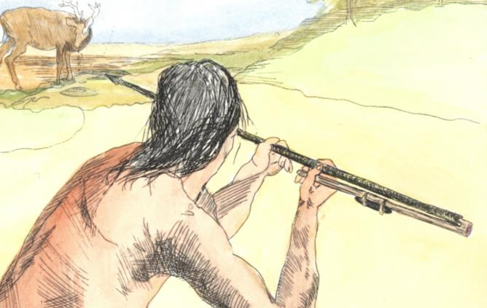
Prehistoric Louisiana
Archaic Period – 8000 to 800 B.C.
Artwork by Paula McIver
Atlatl
Stone Tools
Drawings by David Griffing
Drawings by Phyllis Lear
Archaic Period Tools and Weapons
Notes:
Archaic Period – Tools and Weapons
Archaic people made a wide variety of tools. Hunters used the atlatl, or throwing stick, to hunt deer and smaller mammals. The points attached to the atlatl dart were made of local stone and in a variety of styles. Other stone tools were used to prepare food, and make artifacts out of wood and bone. Sandstone was used to crack and grind nuts and seeds. Axes were often made by grinding a large cobble into the desired shape.
Image credits:
Atlatl – Paula McIver
Stone points – David Griffing
Grinding stone, groundstone axe, and scraper – Phyllis Lear

Slide 16
Prehistoric Louisiana
Archaic Period – 8000 to 800 B.C.
Clay Blocks (drawing by Glenn Kennedy)
Courtesy of Ancient Mounds Commission
Archaic Period People and Settlements
Notes:
Archaic Period – People and Settlements
Archaic people did not move around as much as people in the Paleoindian Period. They continued to live in small family groups that moved occasionally within certain regions. Most artifacts were made of local stone and there was little trade with other groups. People developed a new cooking technology using blocks or balls of fired earth. Like charcoal briquettes, the blocks or balls could be heated, placed in a pit, and used to cook food like an oven.
As early as 5000 B.C., people began building earthen mounds. Louisiana has the oldest mounds in North America. Some mounds may have marked the group’s territory, while others were locations where ceremonies were conducted. Some people may have lived at the mound sites, but many others likely visited them for ceremonial occasions. Archaeologists used to think that people who ate only wild food had to move often to get enough to eat. They thought that those people, called hunter-gatherers, could not stay long enough in one place to build mounds. Research in Louisiana has shown that hunter-gatherers were able to build large and complex mound sites.
Image credits:
Clay blocks – Glenn Kennedy
Watson Brake contour map – Courtesy of Ancient Mounds Commission

Slide 17
Prehistoric Louisiana
Archaic Period – 8000 to 800 B.C.
Poverty Point, West Carroll Parish
Watson Brake, Ouachita Parish
Archaic Period Sites
Notes:
Archaic Period – Archaeological Sites
Here is a map showing two Archaic Period sites in Louisiana. Poverty Point is located in West Carroll Parish, near Monroe. It was built by hunter-gatherers and used around 1700 to 1100 B.C. You can learn more about this important site at Louisiana Division of Archaeology: http://www.crt.la.gov/archaeology (select Discover Archaeology).
Another Archaic site is Watson Brake in Ouachita Parish, also near Monroe. Let’s learn a little more about Watson Brake.
Image credit: Louisiana Division of Archaeology

Slide 18
Prehistoric Louisiana
Drawing by Jon Gibson
Watson Brake, 3500 to 2800 B.C.
Notes:
Archaic Period – Archaeological Site
Watson Brake is a group of 11 mounds arranged in a circle. The mounds are connected by an earth ridge. The circle is about 900 feet across. One of the mounds is 30 feet tall and has a conical shape. The other mounds are smaller and dome-shaped. Archaeologists working at the site found that some mounds were built partway and then the surface was used for activities. Fireplaces were built on some of the mounds. Artifacts indicate that a variety of activities were conducted around the fireplaces. Some people may have lived at the site year-round while others visited for ceremonial occasions. This site was built and used around 3500 to 2800 B.C.
Image credit: Jon Gibson

Slide 19
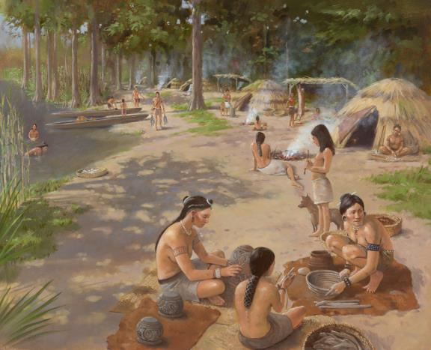
Prehistoric Louisiana
Woodland Period – 800 B.C. to A.D. 1200
Painting by Martin Pate
Woodland Period Climate and Landscape
Notes:
Woodland Period – Climate and Landscape
The Woodland Period, also known as the Early Neo-Indian Period, had a climate much like ours today. Several new things happened during this period. For the first time people made lots of pottery containers. They also started to grow plants for food. Archaeologists found evidence of special ceremonies. Some of the artifacts were similar to the Hopewell Tradition. This cultural tradition included many groups, and it began in the Midwestern United States. This connection meant that people and ideas were traveling long distances.
Image credit: Martin Pate

Slide 20
Prehistoric Louisiana
Woodland Period – 800 B.C. to A.D. 1200
Drawings by Phyllis Lear
Woodland Period Food
Notes:
Woodland Period – Food
Woodland people hunted deer and smaller animals. Fish and shellfish also were important sources of protein. Along the coast and the Atchafalaya Basin, people ate a lot of shellfish and created enormous piles of discarded shells. Some of these piles were hundreds of feet long and up to 25 feet high. People also gathered wild local plants, nuts, seeds and berries. At the end of the period, some people were starting to intentionally grow some plants for food.
People began using ceramic pots to cook and store food in during this period. In the beginning, the pots were thick and broke easily. Later in the period the pottery was thinner and lasted longer. Ceramic pots may have changed how people prepared food and what kinds of food they ate.
Image credit: Phyllis Lear

Slide 21
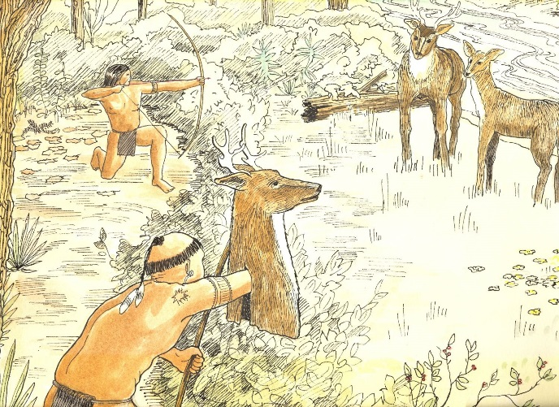
Prehistoric Louisiana
Woodland Period – 800 B.C. to A.D. 1200
Artwork by Paula McIver
Dart Points
Atlatl
Drawing by David Griffing
Artwork by Margaret Humphris
Arrow Points
Drawing by David Griffing
Bow and Arrow
Woodland Period Tools and Weapons
Notes:
Woodland Period – Tools and Weapons
During the first part of the Woodland Period, people hunted with the atlatl. Different styles of stone points were used with the atlatl. In areas where stone was hard to find, some points were made of bone. Deer, alligator and bird bone was ground to a point and attached to the atlatl dart. An important change happened around A.D. 600-700 when the bow and arrow appeared. This new technology allowed people to develop different methods for hunting. Other stone tools, knives, scrapers and drills, remained like those of the Archaic Period.
Image credits:
Stone points – David Griffing
Atlatl – Paula McIver
Bow and arrow – Margaret Humphris

Slide 22
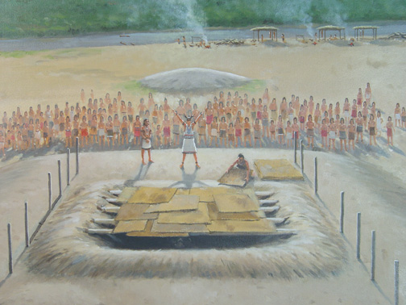
Prehistoric Louisiana
Woodland Period – 800 B.C. to A.D. 1200
Painting by Martin Pate
Woodland Period People and Settlements
Notes:
Woodland Period – People and Settlements
The Woodland Period was a transitional time for people and how they lived. Population grew during this period. In the beginning, most people lived in small camps like their Archaic ancestors. Later, many people lived in larger villages for long periods of time.
People began to build cone-shaped burial mounds around A.D. 1. They also built flat-topped mounds. These mounds were part of a shared culture with the Hopewell Tradition of the Midwestern U.S. By the end of the period, flat-topped mounds were common. Mounds were built on each side of a central plaza where community events and ceremonies were conducted.
Image credit: Martin Pate

Slide 23
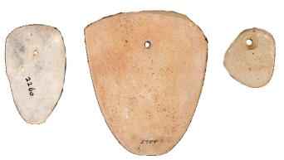
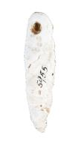
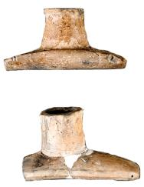
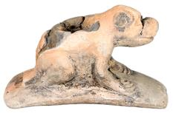
Prehistoric Louisiana
Woodland Period – 800 B.C. to A.D. 1200
Ceramic Pipes
Shell Pendants
Copper (left) and Stone (right) Beads
Photographs by Kevin Duffy
Woodland Period Personal Items
Notes:
Woodland Period – Personal Items
Woodland people used jewelry and other items to show status. Artifacts such as beads made of stone or copper, ceramic pipes and shell pendants were buried with some people. The artifacts show that these individuals were important people in the community.
Image credit: Kevin Duffy

Slide 24
Prehistoric Louisiana
Tchefuncte,
St. Tammany Parish
Woodland Period Site
Notes:
Woodland Period – Archaeological Site
Here is a map showing a Woodland Period site in Louisiana. This is the Tchefuncte site in St. Tammany Parish. It is located just north of New Orleans, on the northeastern shore of Lake Pontchartrain.
Image credit: Louisiana Division of Archaeology

Slide 25
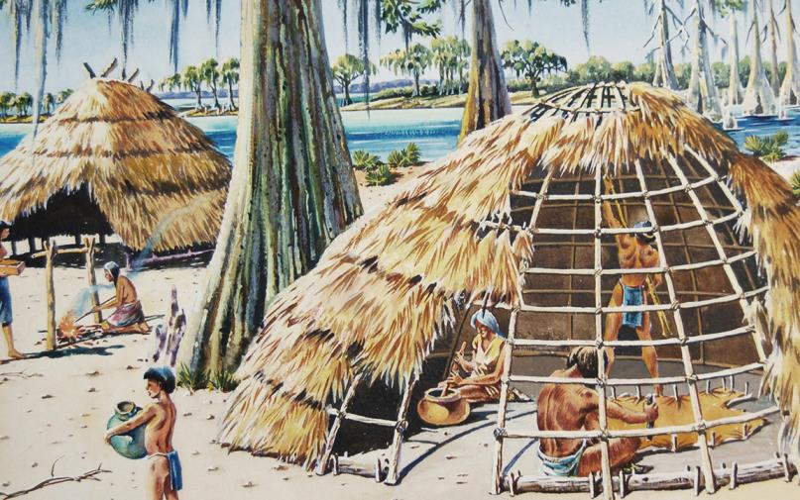
Prehistoric Louisiana
Painting by Jack McLehany, Courtesy of Guaranty Corporation
Tchefuncte Site, 600 to 200 B.C.
Notes:
Woodland Period – Archaeological Site
The Tchefuncte site is located on the bank of a bayou. People began living at the site around 600 B.C. and used it over a period of 400 years. The site was excavated during the 1930s and early 1940s. This was at the end of the Great Depression when many people were out of work. President Roosevelt developed the New Deal to put people back to work, including excavating archaeological sites. Two projects were at the Tchefuncte site.
The excavations at the site found two activity areas where people made and used stone and bone tools. One activity involved grinding up certain stones to make red and yellow powder. The powder may have been used to decorate pots, for use in ceremonies, or for personal decoration. People buried their dead along the back side of the village area.
If you’d like to know more about the Tchefuncte site you can visit the Interactive Exhibit at Louisiana Division of Archaeology http://www.crt.la.gov/archaeology (select Discover Archaeology).
Image credit: Jack McLehany, Courtesy of Guaranty Corporation

Slide 26
Prehistoric Louisiana
Mississippi Period – A.D. 1200 to 1700
Drawing by Phyllis Lear
Mississippi Period Climate and Landscape
Notes:
Mississippi Period – Climate and Landscape
The Mississippi Period is also known as the Late Neo-Indian Period. Climate and sea level during this period was just as it is today. Many different Indian groups lived in Louisiana at this time. They traded together, but spoke their own languages and had many different customs. The arrival of Europeans ended this period.
Image credit: Phyllis Lear

Slide 27
Prehistoric Louisiana
Mississippi Period – A.D. 1200 to 1700
Drawing by Phyllis Lear
Mississippi Period Food
Notes:
Mississippi Period – Food
Hunting, fishing and collecting shellfish and wild plants provided much of the food. A very important change during this time is that some people in Louisiana began raising garden plants like corn, squash and beans. Indians continued to use pottery for cooking and eating during this time.
Image credit: Phyllis Lear

Slide 28
Prehistoric Louisiana
Mississippi Period – A.D. 1200 to 1700
Arrow Points
Drill, Side Scraper, Graver
Drawing by David Griffing
Drawing by Phyllis Lear
Drawings by Phyllis Lear
Mississippi Period Tools and Weapons
Notes:
Mississippi Period – Tools and Weapons
Bows and arrows were still important weapons during the Mississippi Period. Most points and tools were still made of stone. Mississippi Indians made stone tools for cutting, scraping, chopping and grinding. They also made points and tools from wood, shell and bone.
Image credits:
Stone points – David Griffing
Stone points, celt and grinding stone – Phyllis Lear

Slide 29
Prehistoric Louisiana
Mississippi Period – A.D. 1200 to 1700
Drawing by Phyllis Lear
Mississippi Period People and Settlements
Notes:
Mississippi Period – People and Settlements
Populations continued to grow during this period. Villages were larger and were occupied for longer periods of time. Some villages extended for a mile or more along a river bank. Some sites had flat-topped mounds. Important people may have lived on these mounds or conducted ceremonies on them. Mississippian people traded with other folks for stone, shell and other materials.
Image credit: Phyllis Lear

Slide 30
Prehistoric Louisiana
Mississippi Period – A.D. 1200 to 1700
Coles Creek Incised jar
Mississippi Plain jar
Hickory Engraved bottle
Glassell Engraved bowl
Kamack Brushed jar
Drawing by Jeff Girard
Drawings by Phyllis Lear
Mississippi salt pan
Drawings by Phyllis Lear
Mississippi Period Ceramics
Notes:
Mississippi Period – Ceramics
Ceramic pots were made in a wide variety of shapes and sizes. Many had beautiful designs drawn or scratched on the surface. These designs may have had religious or ceremonial meanings, or simply showed the skill of the artist.
Image credits: Jeff Girard (far left drawing) and Phyllis Lear (all others)

Slide 31
Prehistoric Louisiana
Mississippi Period – A.D. 1200 to 1700
ceramic pipe
copper ear spools
engraved shell cup
ceramic effigy
ceremonial knife
long-nosed god copper ear ornament
ceremonial
greenstone celts
Drawings by Phyllis Lear
Mississippi Period Ceremonial Items
Notes:
Mississippi Period – Ceremonial Items
Other artifacts were clearly made for ceremonial use. These include smoking pipes, carved shell cups, and effigies of animals and people.
Image credit: Phyllis Lear

Slide 32
Prehistoric Louisiana
Mississippi Period – A.D. 1200 to 1700
McClelland and
Joe Clark
Bossier Parish
Mississippi Period Sites
Notes:
Mississippi Period – Archaeological Sites
Here is a map showing two Mississippi Period sites in Louisiana. These are the McLelland and Joe Clark sites in Bossier Parish. They are located just south of Shreveport.
Image credit: Louisiana Division of Archaeology

Slide 33
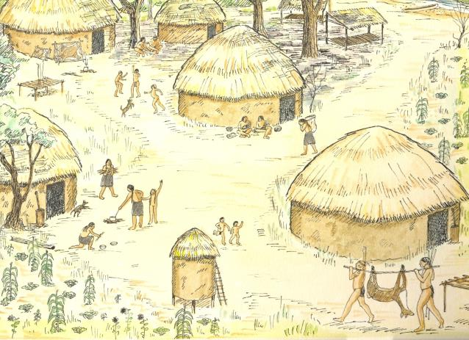
Prehistoric Louisiana
Mississippi Period – A.D. 1200 to 1700
Artwork by Margaret Humphris
Caddo Hamlet
Notes:
Mississippi Period – Archaeological Site
The McLelland and Joe Clark sites are examples of Caddo culture in Louisiana. The Caddo culture flourished during the Mississippi Period. Caddo Indians were here when Europeans arrived, and many still call parts of Louisiana home. The Caddo Indians were known for their hamlets, or small settlements, and farmsteads. This is a drawing of what a Caddo hamlet might have looked like.
Archaeologists discovered that people lived at the McLelland and Joe Clark sites year round. They know this because of the plant and animal remains at both sites. Archaeologists also know from these remains that these people hunted, fished, gathered wild foods and grew crops. Each site was occupied by extended families of about 15-20 people, which was typical of a Caddo farmstead. Archaeologists did not find evidence of mound building at these sites.
Image credit: Margaret Humphris

Slide 34
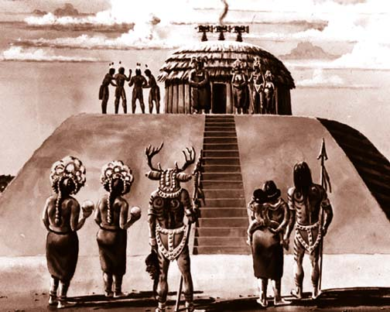
Prehistoric Louisiana
Painting by Jack McLehany, courtesy of Guaranty Corporation
Mississippi Period Ceremony
Notes:
Prehistoric Louisiana
The Mississippi Period was at the end of the prehistory of Louisiana. This image is of a Mississippi Period ceremony. Just before A.D. 1700, French explorers came to Louisiana. This changed things for Louisiana Indians.
Image credit: Painting by Jack McLehany, courtesy of Guaranty Corporation

Slide 35
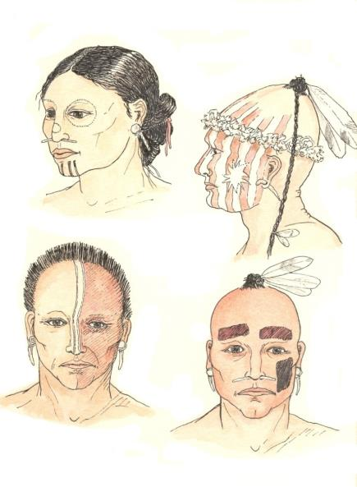
Prehistoric Louisiana
Caddo
Taensa
Atakapa
Bayogoula
Artwork by Margaret Humphris
Louisiana Indians
Notes:
Wrap Up for Module
This module was a brief introduction to the prehistory of Louisiana. Many cultures lived here through time. In this slide we see a few of the Indians who called Louisiana home. We also learned that each period changed some things from the previous one, while some things remained the same. Louisiana Indians adapted to their changing world, environmentally and socially. Each group left behind artifacts that gave us clues about daily life. Sometimes objects told us about special ceremonies, or connections with other cultures.
Louisiana’s prehistoric sites are special. Archaeologists learn a lot from these sites. This information is available for present and future generations to appreciate.
You can find out more about Louisiana prehistory from virtual books and interactive exhibits at the Louisiana Division of Archaeology: http://www.crt.la.gov/archaeology (select Discover Archaeology).
Image credit: Margaret Humphris

Slide 36
Prehistoric Louisiana
This presentation is one in a series of modules about Louisiana archaeology. Each module has a PowerPoint presentation and associated student activities. The series is called “Learn about Louisiana’s Past through Archaeology.”
This presentation is intended for educational use. Please use image credits where provided.
Please visit the Division of Archaeology website for additional teaching materials and educational resources at: http://www.crt.la.gov/archaeology/ (select Discover Archaeology).
Presented by:
Louisiana Division of Archaeology
Office of Cultural Development
Department of Culture, Recreation and Tourism
Office of the Lieutenant Governor
Baton Rouge, Louisiana
This project was made possible through the Governor's Office of Homeland Security and Emergency Preparedness (GOHSEP) and the Federal Emergency Management Agency (FEMA) as part of implementing the Louisiana Hazard Mitigation Grant Program for Hurricane Katrina recovery.
© Louisiana Division of Archaeology 2016

